Slide 1
Design of Analog Integrated Circuit
VO Tuan minh
Faculty of Electronics and Telecommunication Engineering
University of Science and Technology - The University of Danang

Slide 2
Chủ đề
Giới thiệu Thiết kế vi mạch & Đặc tính của MOSFET
Mạch khuếch đại đơn
Mạch khuếch đại vi sai
Mạch gương dòng & Kỹ thuật phân cực
Đáp ứng tần số
Bộ chuyển đổi tương tự/số
Bộ chuyển đổi số/tương tự
Vòng khóa pha

Slide 3
Overview
CMOS Comparators
Analog Digital Converters

Slide 4
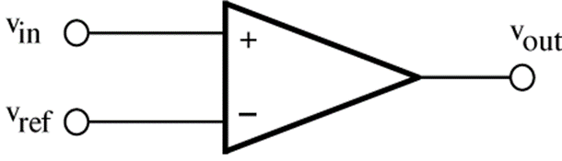
Voltage comparators
A comparator detects if its input is higher or lower than a reference level.
Its output is a large voltage which is assumed to represent a digital 1 or 0 level.
If v_{in} > v_{ref} => v_{out} = “1”
If v_{in} < v_{ref} => v_{out} = “0”

Slide 5
Design Considerations
Accuracy (offset, noise, resolution)
Settling time (tracking BW, regeneration speed)
Sensitivity (gain)
Metastability (any decision is better than no decision!)
Overdrive recovery (memory)
CMRR
Power consumption

Slide 6
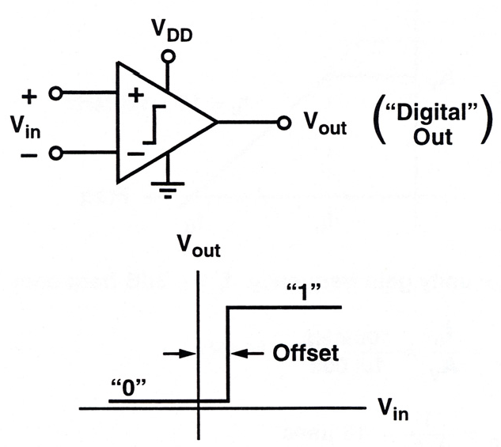
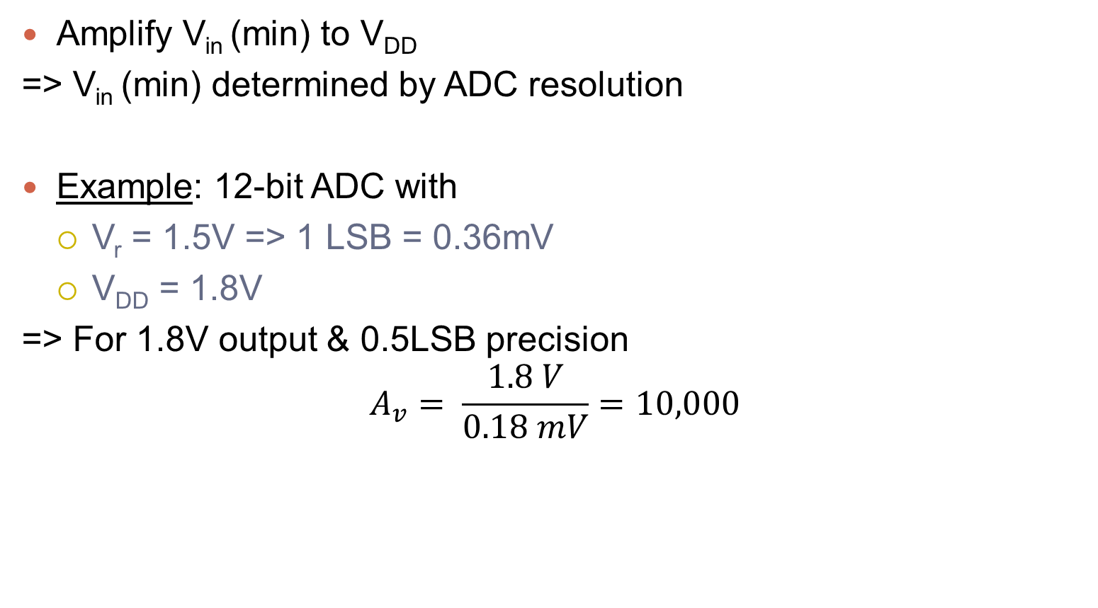
High-Gain Amplifiers
Amplify V_{in} (min) to V_{DD}
=> V_{in} (min) determined by ADC resolution
Example: 12-bit ADC with
  V_{r} = 1.5V => 1 LSB = 0.36mV
  V_{DD} = 1.8V
=> For 1.8V output & 0.5LSB precision
$$A_{v}= \frac{1.8 V}{0.18 mV}=10,000$$

Slide 7
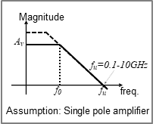
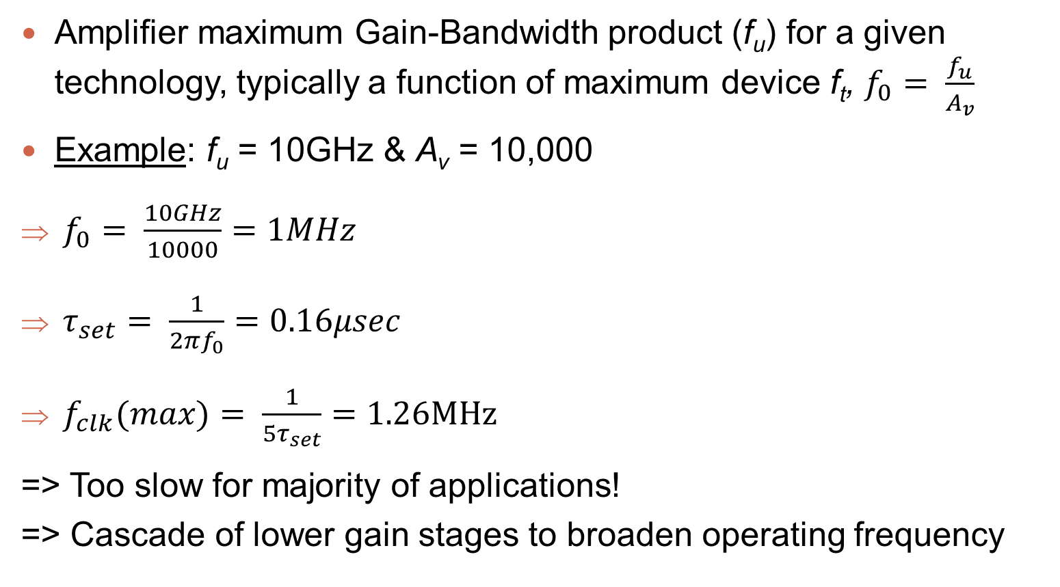
Single-Stage Amplification
Amplifier maximum Gain-Bandwidth product (f_{u}) for a given technology, typically a function of maximum device f_{t}, $f_{0}= \frac{f_{u}}{A_{v}}$
Example: f_{u} = 10GHz & A_{v} = 10,000
$f_{0}= \frac{10GHz}{10000}=1MHz$
$τ_{set}= \frac{1}{2πf_{0}}=0.16μsec$
$f_{clk}(max)= \frac{1}{5τ_{set}}=1.26MHz$
=> Too slow for majority of applications!
=> Cascade of lower gain stages to broaden operating frequency

Slide 8
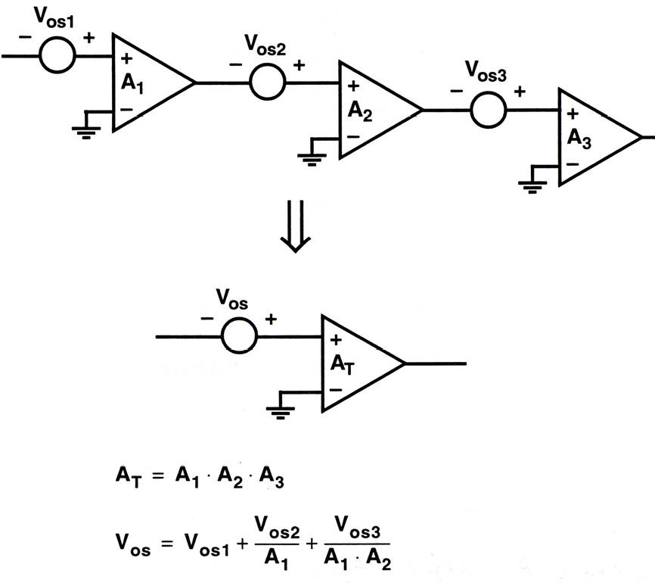
Open Loop Cascade of Amplifiers

Slide 9
Offset Cancellation
In sampled-data cascade of amplifiers V_{os} can be cancelled
  Store on ac-coupling caps in series with amp stages
Offset associated with a specific amp can be cancelled by storing it in series with either the input or the output of that stage

Slide 10
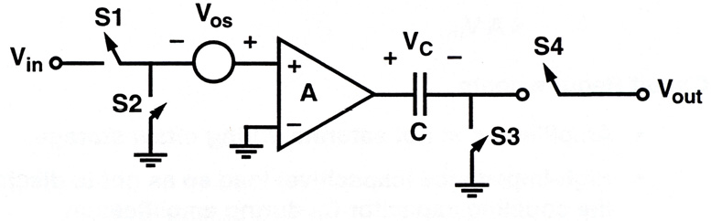
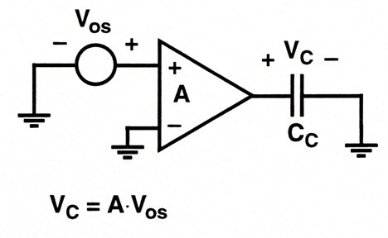
Output Series Cancellation
Amp modeled as ideal + V_{os} (input referred)
Store offset:
  S1, S4: open
  S2, S3: closed
  => V_{C} = A⸱V_{OS}

Slide 11
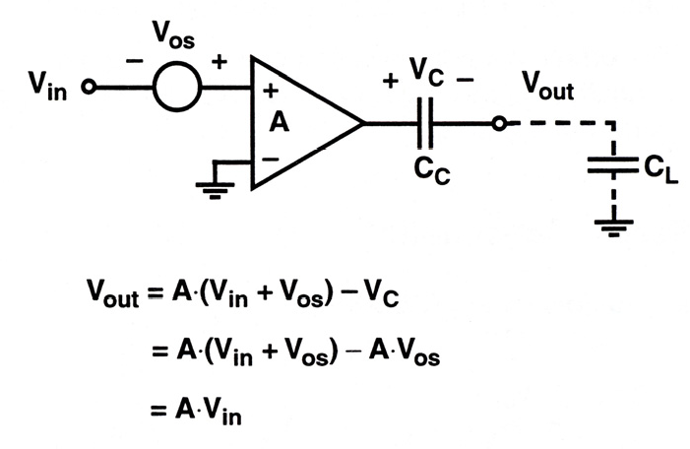
Output Series Cancellation
Amplify:
  S2, S3: open
  S1, S4: closed
  V_{C} = A⸱V_{OS}
Circuit requirements:
  Amp not saturate during offset storage
  High-impedance (C) load -> C_{c} not discharged
  Cc >> CL to avoid attenuation
  Cc >> C_{sw} to avoid excessive offset due to charge injection

Slide 12
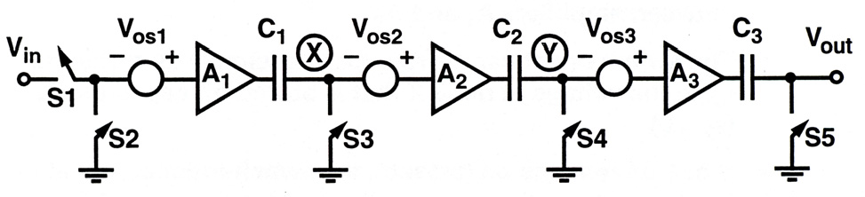
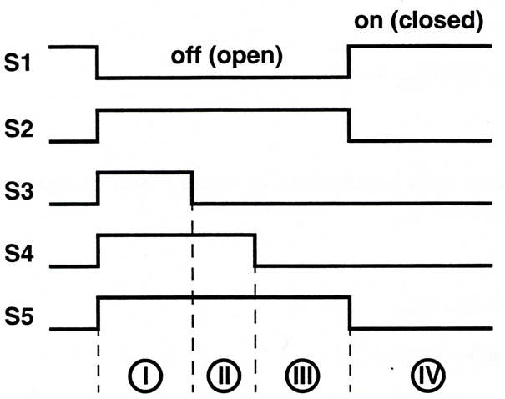
Cascaded Output Series Cancellation
Note: Offset storage in capacitors connected in series with amplifier outputs

Slide 13
Cascaded Output Series Cancellation
S1: open
S2, S3, S4, S5: closed

Slide 14
Cascaded Output Series Cancellation
S3: open
Feedthrough of S3: offset on X
Switch offset, ε₃ induced on X
S4 remains closed, offset
associated with ε₃ stored on C2

Slide 15
Cascaded Output Series Cancellation
S4: open
Feedthrough of S4: offset on Y
Switch offset, ε₄ induced on Y
S5 remains closed, offset
associated with ε₄ stored on C3

Slide 16
Cascaded Output Series Cancellation
S2, S5: open, S1: closed
Input connected to low
impedance source charge
injection: not of major concern
Switch offset, ε₅ introduced due
to S5 opening

Slide 17
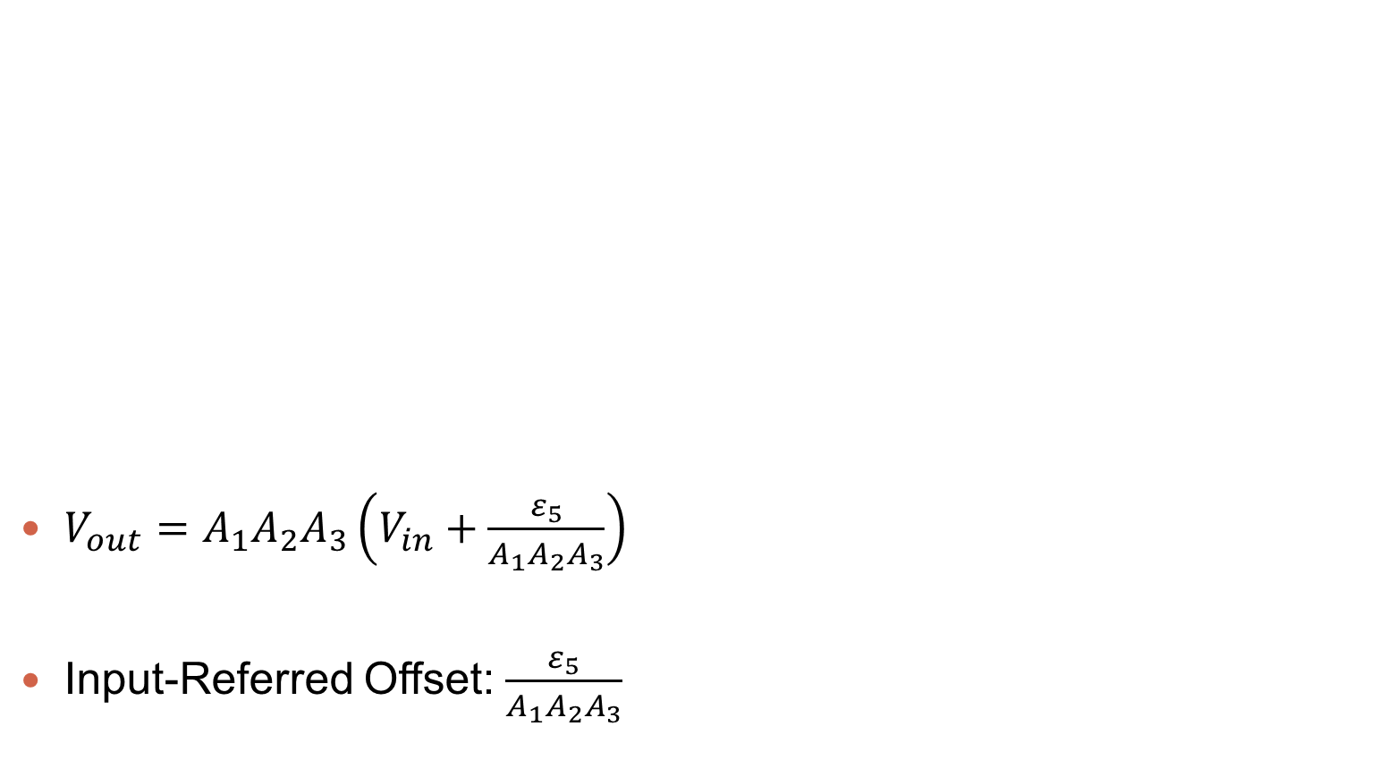
Cascaded Output Series Cancellation
$V_{out}=A_{1}A_{2}A_{3}\left(V_{in}+\frac{ε_{5}}{A_{1}A_{2}A_{3}}\right)$
Input-Referred Offset: $\frac{ε_{5}}{A_{1}A_{2}A_{3}}$

Slide 18
Cascaded Output Series Cancellation
Advantages:
  Almost compete cancellation
  Closed-loop stability not required
Disadvantages:
  Gain per stage must be small
  Offset storage C in the signal path => could slow down overall performance

Slide 19
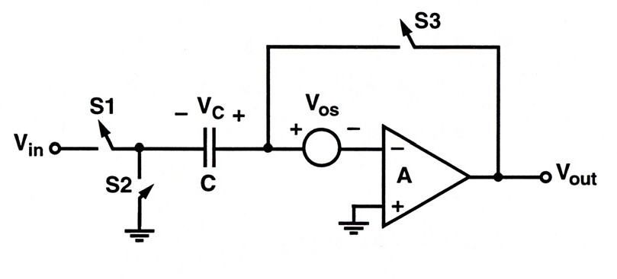
Input Series Cancellation

Slide 20
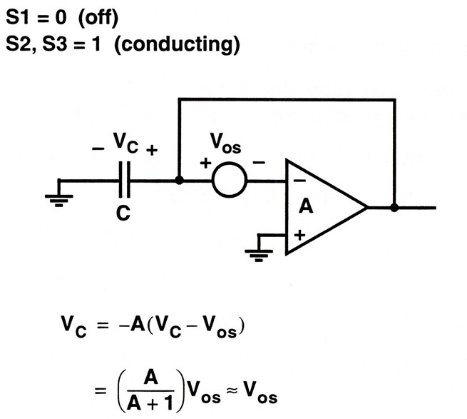
Input Series Cancellation
Store offset:
Note: Mandates closed-loop
stability

Slide 21
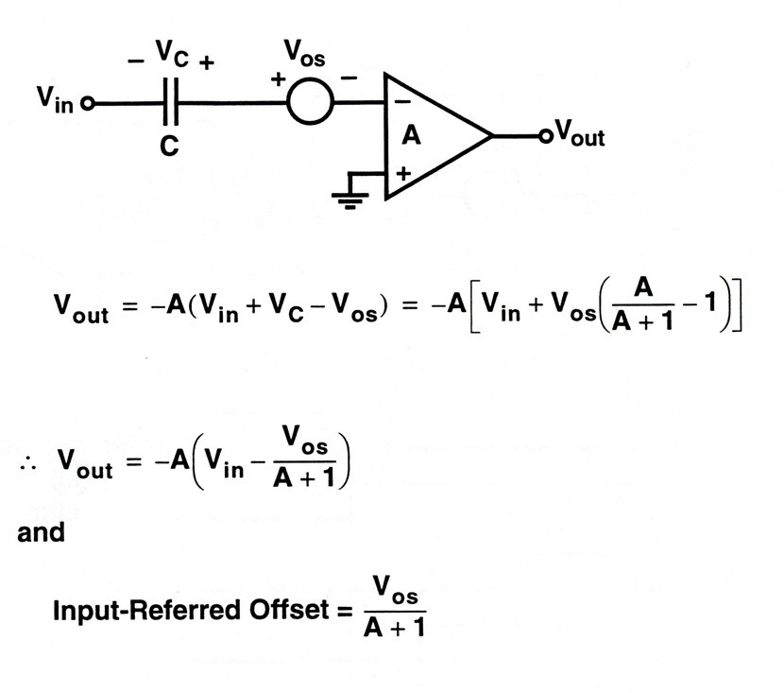
Input Series Cancellation
Amplify:
  S2, S3: open
  S1: closed

Slide 22
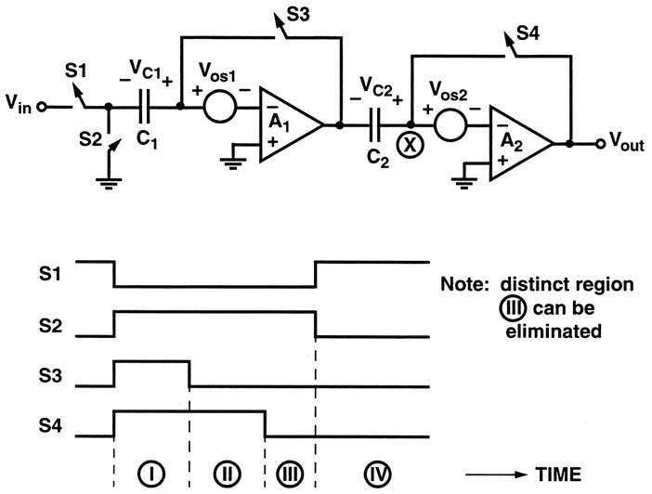
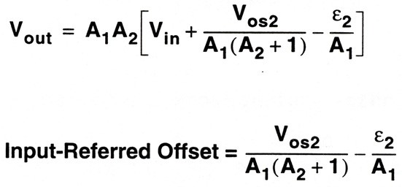
Cascaded Input Series Cancellation
ε₂: charge injection associated with opening of S4

Slide 23
Input Series Cancellation
Advantages:
  In applications such as C-array successive approximation ADCs can use C-array to store offset
Disadvantages:
  Cancellation not complete
  Requires closed loop stability
  Offset storage C in the signal path, could slow down overall performance

Slide 24
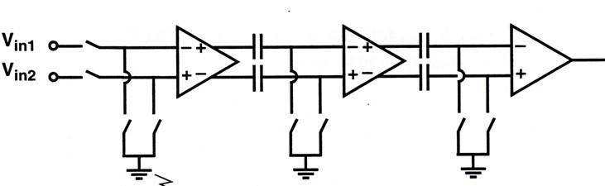
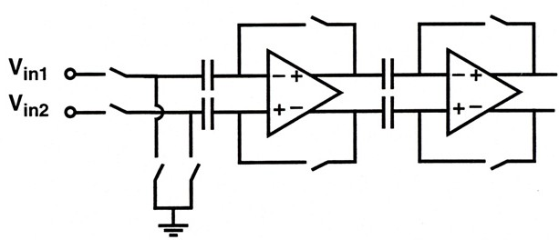
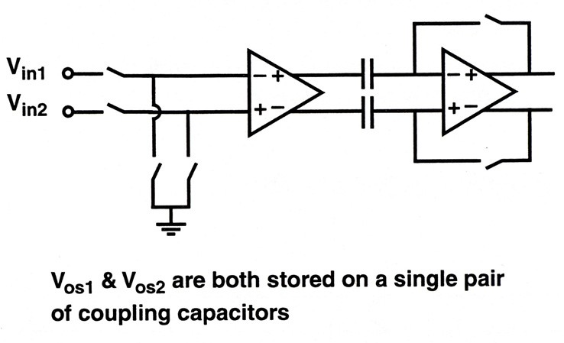
Cascade of Gain Stages
Fully differential gain stages: 1st order cancellation of switch feedthrough offset
Output series offset cancellation
Input series offset cancellation
Combined input & output series
offset cancellation

Slide 25
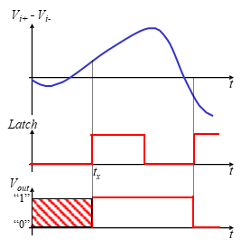
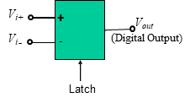
Latched Comparators
Compares two input voltages at time t_{x} & generates a digital output:
  If V_{i+} > V_{i-} => V_{out} = “1”
  If V_{i-} < V_{i+} => V_{out} = “0”

Slide 26
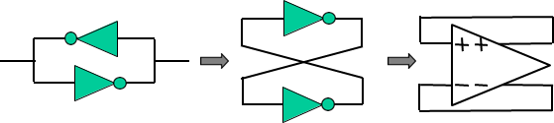
Latched Comparators
Comparator amplification need not be linear => can use a latch => regeneration
Latch => Amplification + positive feedback

Slide 27
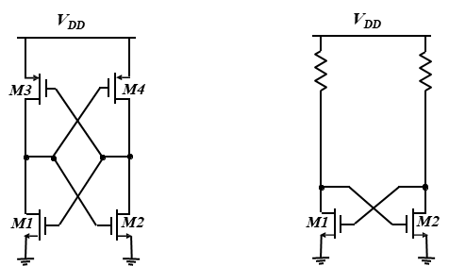
Simplest Form of Latch

Slide 28
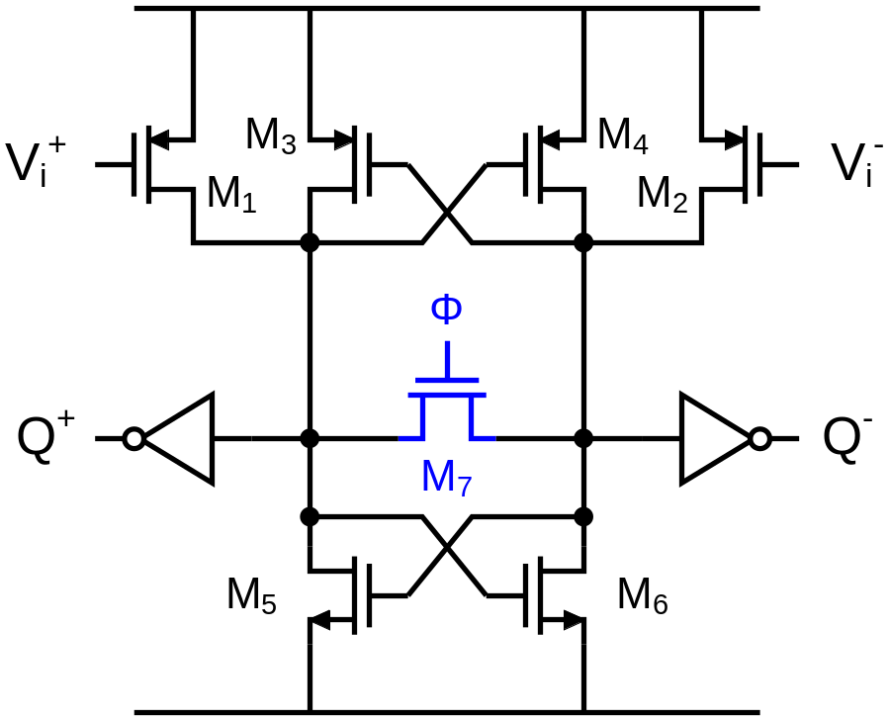
Static Latch
Active pull-up and pull-down → full CMOS logic levels
Very fast!
Q+ and Q- are not well defined in reset mode (Φ = 1)
Large short-circuit current in reset mode
Zero DC current after full regeneration
Very noisy

Slide 29
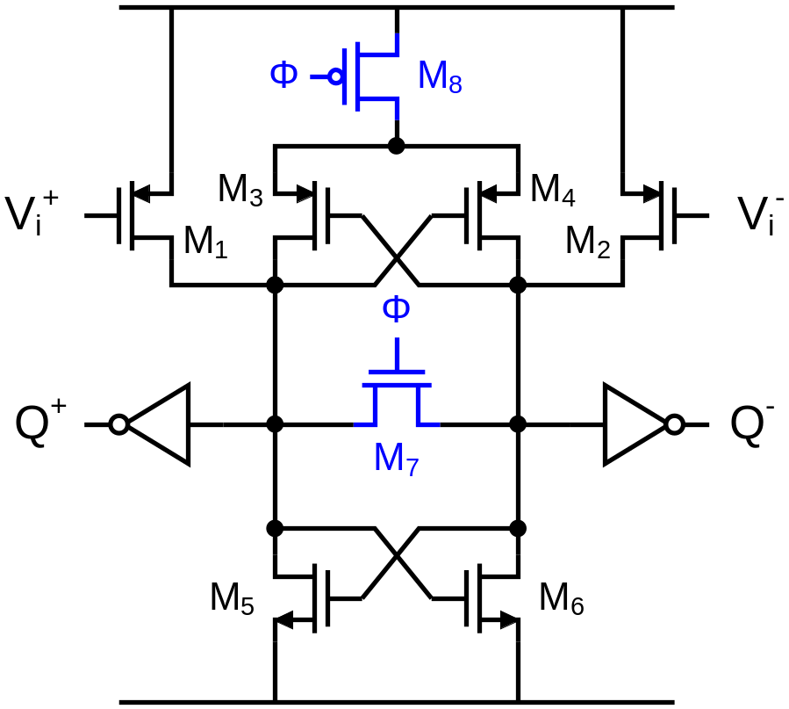
Semi-Dynamic Latch
Diode divider disabled in reset mode → less short-circuit current
Pull-up not as fast
Q+ and Q- are still not well defined in reset mode (Φ = 1)
Zero DC current after full regeneration
Still very noisy

Slide 30
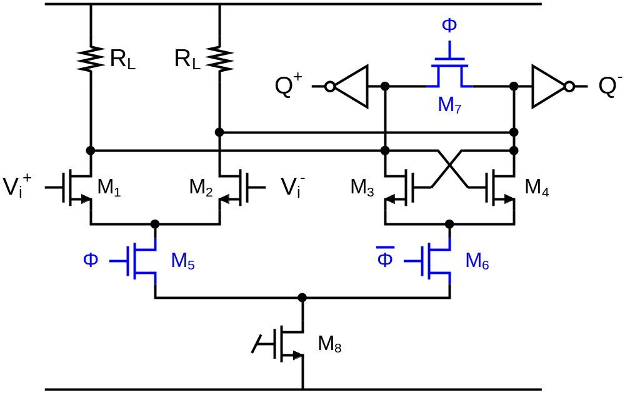
Current-Steering Latch
Constant current → very quiet
Higher gain in tracking mode
Cannot produce full logic levels
Fast

Slide 31
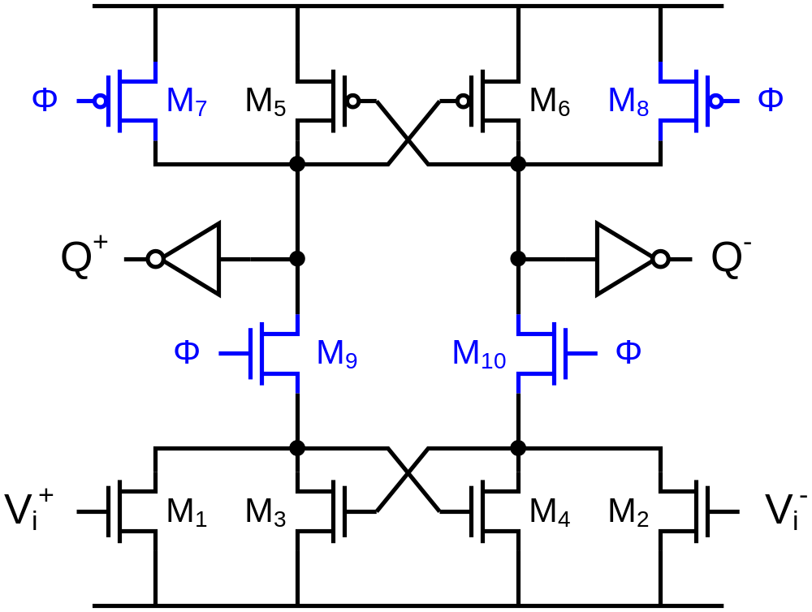
Dynamic Latch
Zero DC current in reset mode
Q+ and Q- are both reset to “0”
Full logic level after regeneration
Slow
X
Y
M
N

Slide 32
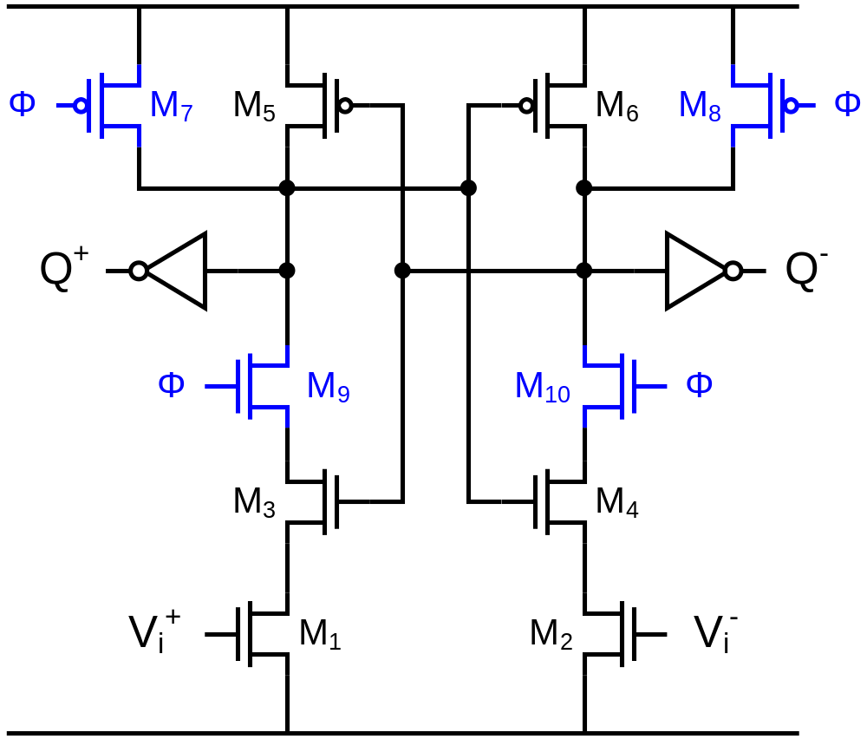
Modified Dynamic Latch
Zero DC current in reset mode
Q+ and Q- are both reset to “0”
Full logic level after regeneration
Slow
X
Y
N
M

Slide 33
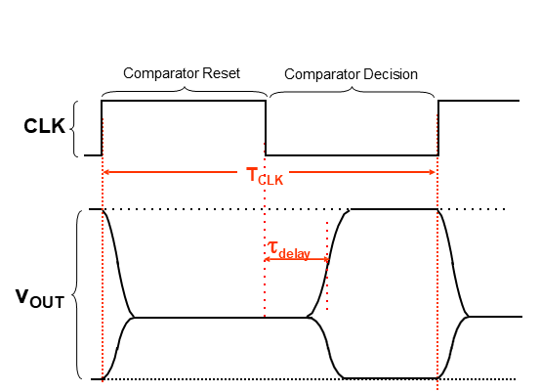
Comparator Dynamic Behavior

Slide 34
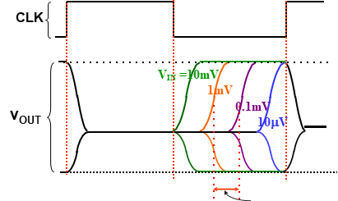
Comparator Resolution
Δt = (g_{m}/C).ln(V_{in1}/V_{in2})

Slide 35
Latch-Only Comparator
Much faster compared to cascade of open-loop amplifiers
Main problem associated with latch-only comparator topology
  High input-referred offset voltage (as high as 100mV!)
    Solution: Use preamplifier to amplify the signal and reduce overall input-referred offset

Slide 36
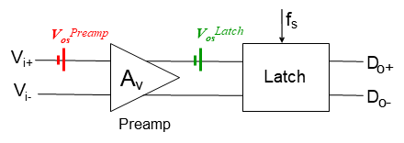
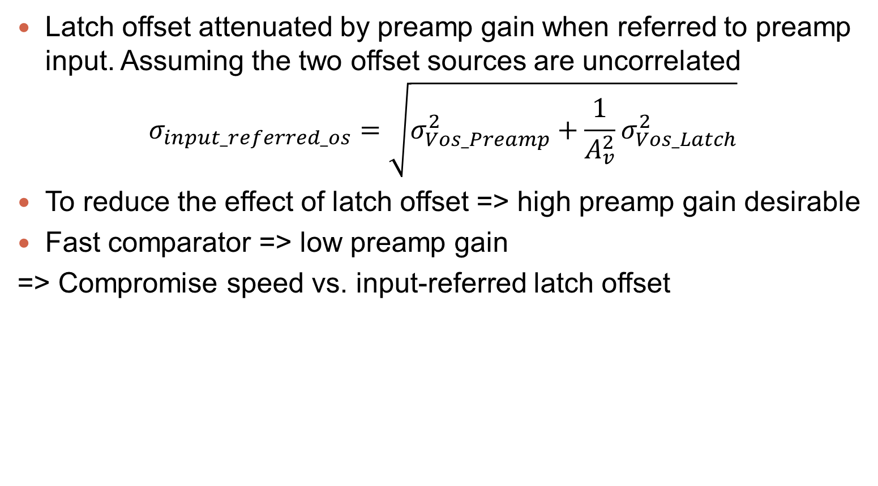
Pre-Amplifier + Latch
Latch offset attenuated by preamp gain when referred to preamp input. Assuming the two offset sources are uncorrelated
$$σ_{input_referred_os}=\sqrt{σ_{Vos_Preamp}^{2}+\frac{1}{A_{v}^{2}}σ_{Vos_Latch}^{2}}$$
To reduce the effect of latch offset => high preamp gain desirable
Fast comparator => low preamp gain
=> Compromise speed vs. input-referred latch offset

Slide 37
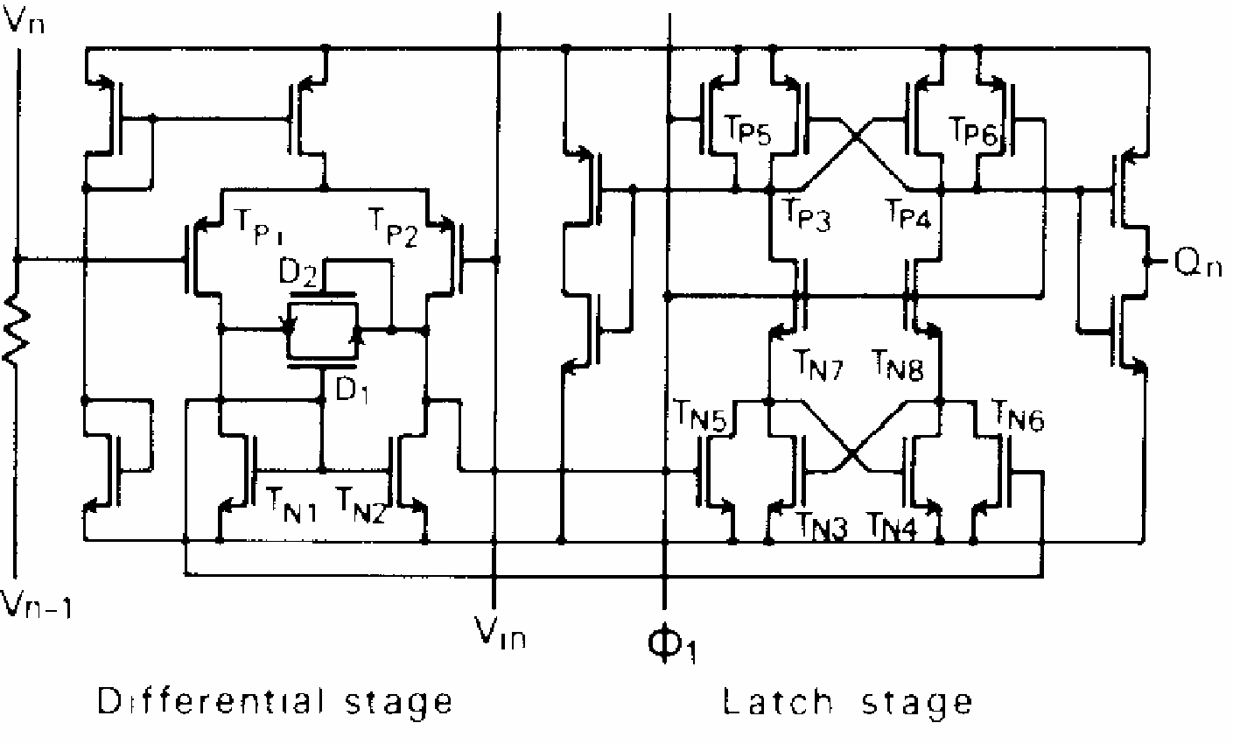
CMOS Comparator Example

Slide 38
Overview
CMOS Comparators
Analog Digital Converters

Slide 39
What is ADC?
An electronic circuit which transforms a signal from analog (continuous) to digital (discrete) form.
Analog signals are directly measurable quantities.
Digital signals only have two states. For digital computer, we refer to binary states, 0 and 1.
Why ADC is needed?
Microprocessors can only perform complex processing on digitized signals.
When signals are in digital form, they are less susceptible to the deleterious effects of additive noise.
ADC provides a link between the analog world of transducers and the digital world of signal processing and data handling.

Slide 40
The Measurement & Control Loop
N
bits
ANALOG
SIGNAL
PROCESSOR
A - D
CONVERTER
MUX
Operational Amp
Differential Amp
Instrumentation Amp
Isolation Amp
Multiplier/Divider
Log Amplifier
rms-dc Converter
F-V/V-F Converter
MICRO
PROCESSOR
OR
DSP
PROCESSOR
REFERENCE
ANALOG
SIGNAL
PROCESSOR
D - A
CONVERTER
MUX
N
bits
Notes:
The basic measurement and control loop measures a process variable and determines what control action needs to be performed based on the processor’s control algorithm. The measurement path takes an analog variable (such as pressure, temperature etc), signal conditions it in the analog domain before applying it to an analog-to-digital converter (ADC). The ADC provides a digital output corresponding to the value of the analog input signal relative to the reference voltage. The resolution of the converter determines the number of bits (n) in the digital representation.
On the control side, the digital word from the processor is converted to an analog value using a digital-to-analog converter (DAC). The number of digital bits which are convereted to an anlog value is determined by the resolution of the DAC.

Slide 41
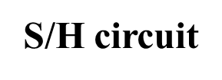
ADC process
Input analog signal
u_{I}(t)
Output digital signal
n-1
D
Quantizing & Encoding
…
S
u_{I}′(t)
D₁
C
D₀
2 steps
Sampling and Holding (S/H)
Quantizing and Encoding (Q/E)

Slide 42
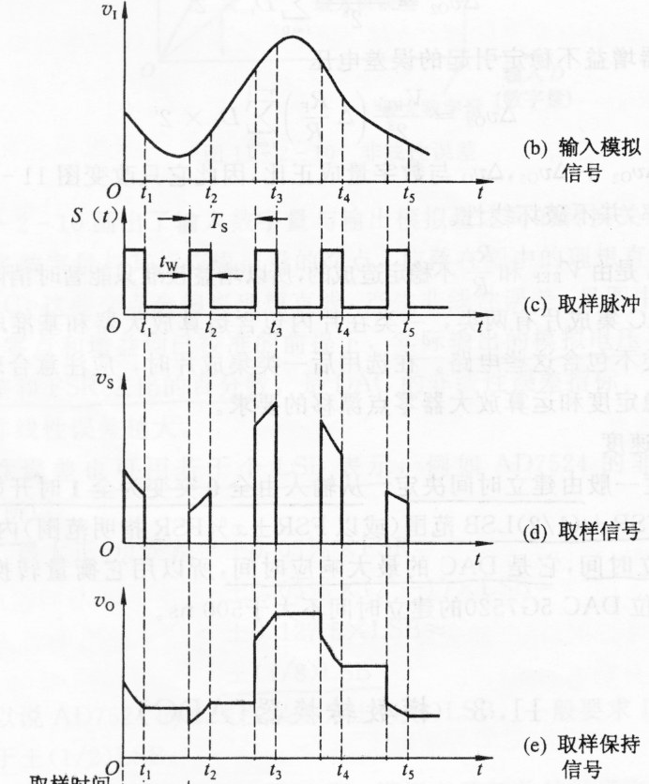
Sampling and Holding
Holding signal benefits the accuracy of the A/D conversion
Minimum sampling rate should be at least twice the highest data frequency of the analog signal
Continuous Signal
Sampling pulse
Sampled signal
Sampled and hold signal

Slide 43
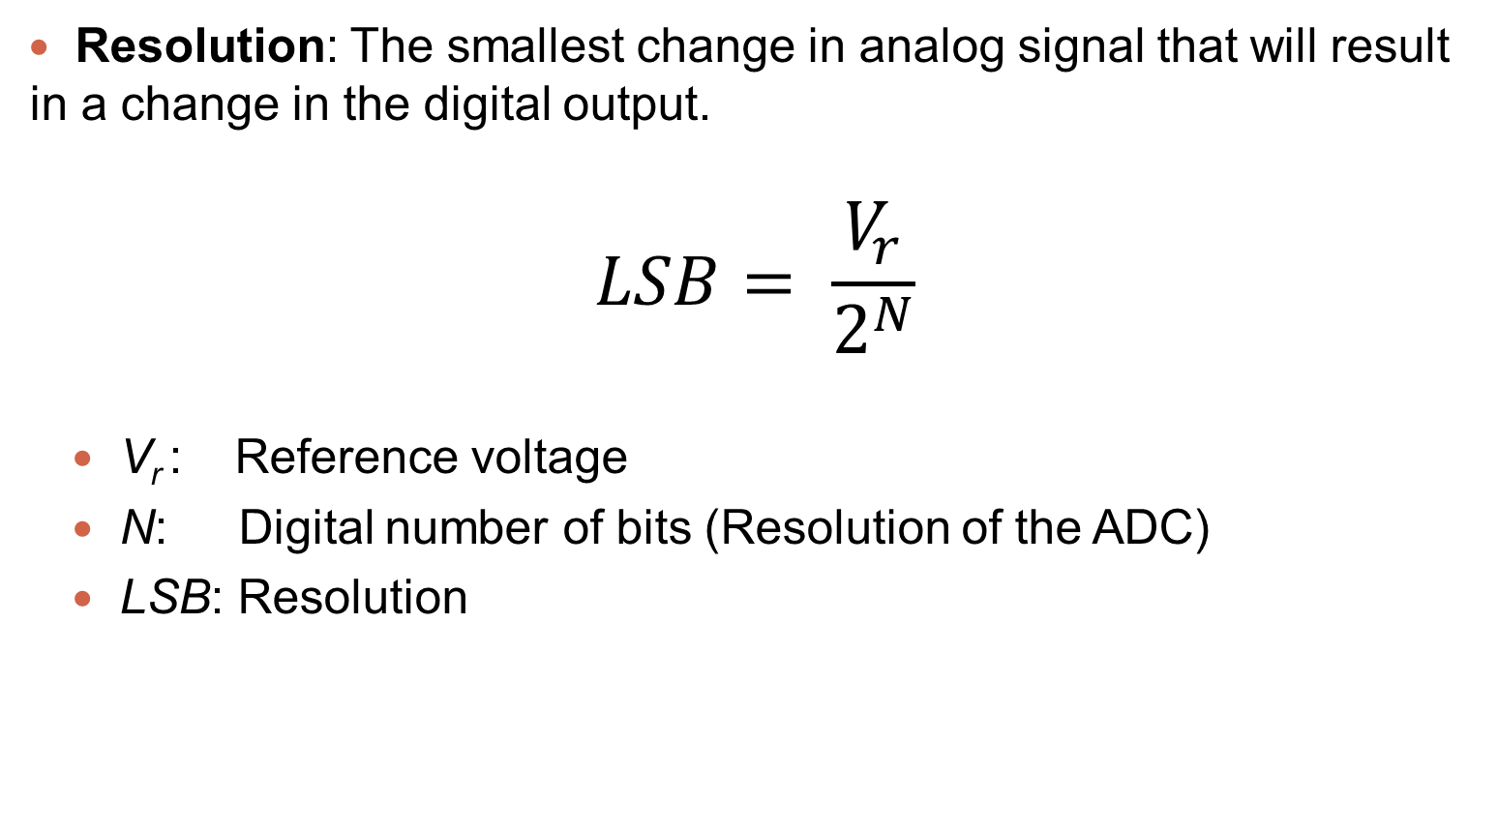
Quantizing and Encoding
Resolution: The smallest change in analog signal that will result in a change in the digital output.
$$LSB= \frac{V_{r}}{2^{N}}$$
V_{r} : Reference voltage
N: Digital number of bits (Resolution of the ADC)
LSB: Resolution

Slide 44
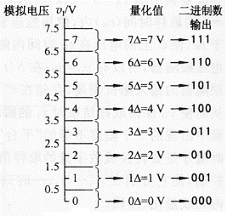
Quantizing and Encoding
Quantizing:
Partitioning the reference signal range into a number of discrete quanta, then matching the input signal to the correct quantum.
Encoding:
Assigning a unique digital code to each quantum, then allocating the digital code to the input signal.
Analog Signal
Digital Output in Binary

Slide 45
IDEAL ADC input vs. output
Ideal ADC code transitions are exactly 1 LSB apart.
For an N-bit ADC, there are 2^{N} codes.
Each “step” is centered on an eighth of full scale
111
110
101
DIGITAL OUTPUT
100
011
1 LSB
010
001
1/8 2/8 3/8 4/8 5/8 6/8 7/8
ANALOG INPUT
Notes:
This shows the conversion relationship for an ideal 3-bit converter. The smallest resolvable signal is 1 LSB which is equal to FS/2³ or FS/8. The digital output has 8 discrete values representing a linear transfer function.

Slide 46
Quantization Noise
111
110
101
DIGITAL OUTPUT
100
011
010
001
1/8
2/8
3/8
4/8
5/8
6/8
7/8
FS
NORMALIZED ANALOG INPUT
q = 1 LSB
quantization noise error
Notes:
We have previously talked about quantization errors and how they determine dynamic range etc. This plots shows the profile of the quantization error as it tracks a ramped analog input voltage. At the centre of each of the codes, the quantization error is 0. As the input voltage increases but the digital code remains constant, the quantization error goes negative. At the next code transition, the digital output now jumps ahead of the analog input voltage ramp and quantization error jumps positive. The profile is repeated at each code of the ADC transfer function.

Slide 47
Quantization Noise (con’t)
+q/2
0 volts
-q/2
The RMS value of the quantization noise sawtooth is its peak value, q÷2, divided by √3, or q÷√12
For Sine Wave Full Scale RMS Value is 2^{(N-1)}q/√2
Thus S/N (in amplitude) is 1.225 x 2^{N}
Expressed in dB [20log₁₀(S/N)] as 1.76 + 6.02N
Notes:
Read through Bullets

Slide 48
Quantization Noise (con’t)
HARMONICS OF F_{SIGNAL}
(EXAGGERATED FOR CLARITY)
OUTPUT
RMS
QUANTIZATION NOISE
F_{SIGNAL}
F_{S}/2
F_{S}
If the quantization noise is uncorrelated with the frequency of the AC input signal, the noise will be spread evenly over the Nyquist bandwidth of F_{s}/2.
If, however the input signal is locked to a sub-multiple of the sampling frequency, the quantization noise will no longer appear uniform, but as harmonics of the fundamental frequency
Notes:
A graphical representation of this RMS error in the frequency domain is shown and is called quantization noise, also referred to as noise spectral density. Remember, this is the quantization error in an ideal converter and is uniformly distributed across frequencies. One thing to note is this is sometimes also called the noise floor. And that the magnitude is dependent on the quantization level (resolution) and sample rate. It’s easy to see that with the same resolution converter, by doubling the sampling rate, the noise floor gets spread over a wider bandwidth. This is called processing gain. By doubling the sample rate, one obtains a 3dB improvement (lowering) of the noise floor or sometimes called “3dB of processing gain”.

Slide 49
Accuracy of A/D Conversion
There are two ways to best improve the accuracy of A/D conversion:
  increasing the resolution which improves the accuracy in measuring the amplitude of the analog signal.
  increasing the sampling rate which increases the maximum frequency that can be measured.

Slide 50
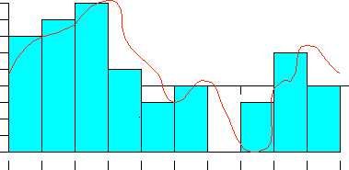
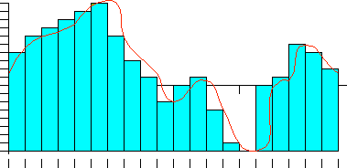
Accuracy of A/D Conversion
Low Accuracy  Improved
Time
Time
Resolution
Resolution

Slide 51
Types of ADC
Dual Slope
Successive Approximation Register
Flash
Delta-Sigma
Pipelined Sub-ranging

Slide 52
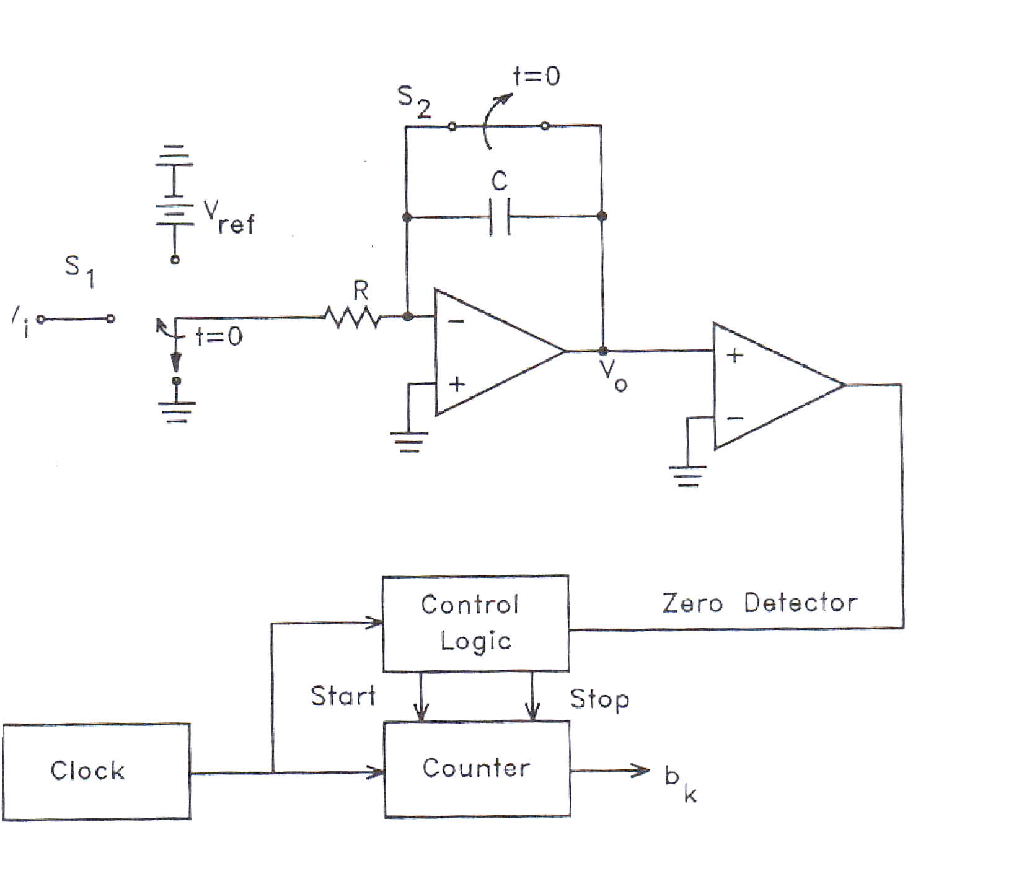
Dual Slope A/D Converter
Fundamental components
  Integrator
  Electronically Controlled Switches
  Counter
  Clock
  Control Logic
  Comparator

Slide 53
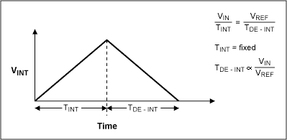
How does it work?
A dual-slope ADC integrates an unknown input voltage (V_{IN}) for a fixed amount of time (T_{INT}), then "de-integrates" (T_{DE-INT}) using a known reference voltage (V_{REF}) for a variable amount of time.
The key advantage of this architecture over the single-slope is that the final conversion result is insensitive to errors in the component values. That is, any error introduced by a component value during the integrate cycle will be cancelled out during the de-integrate phase.

Slide 54
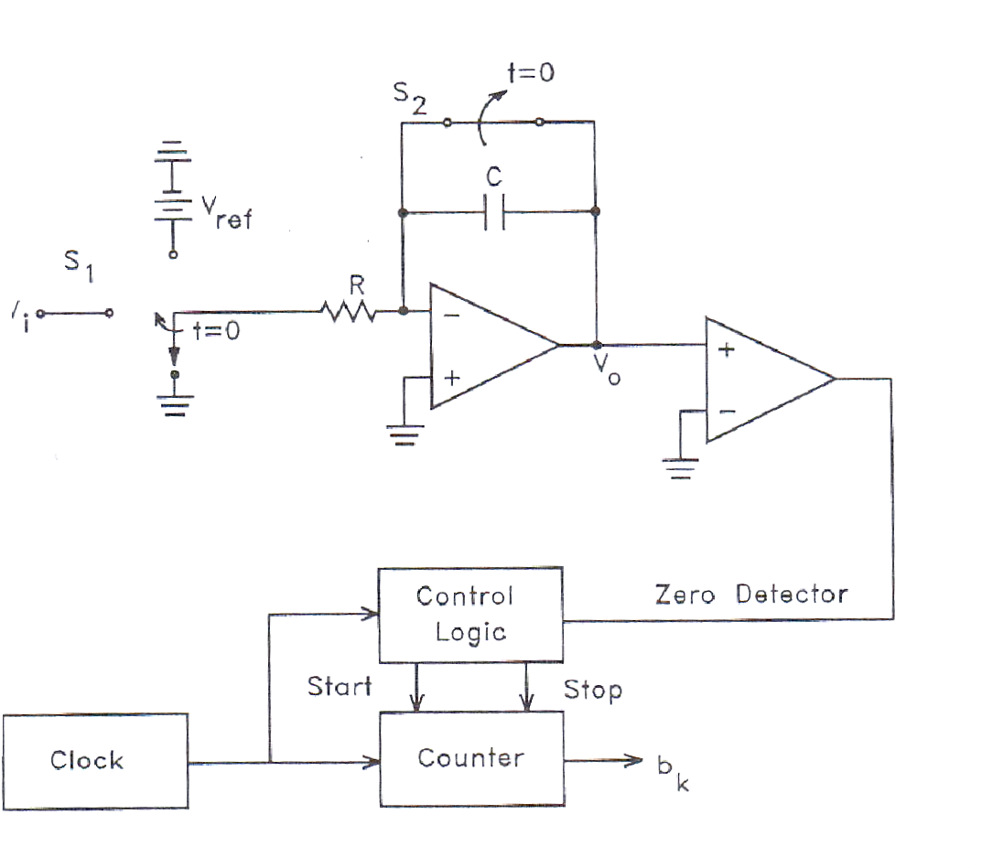
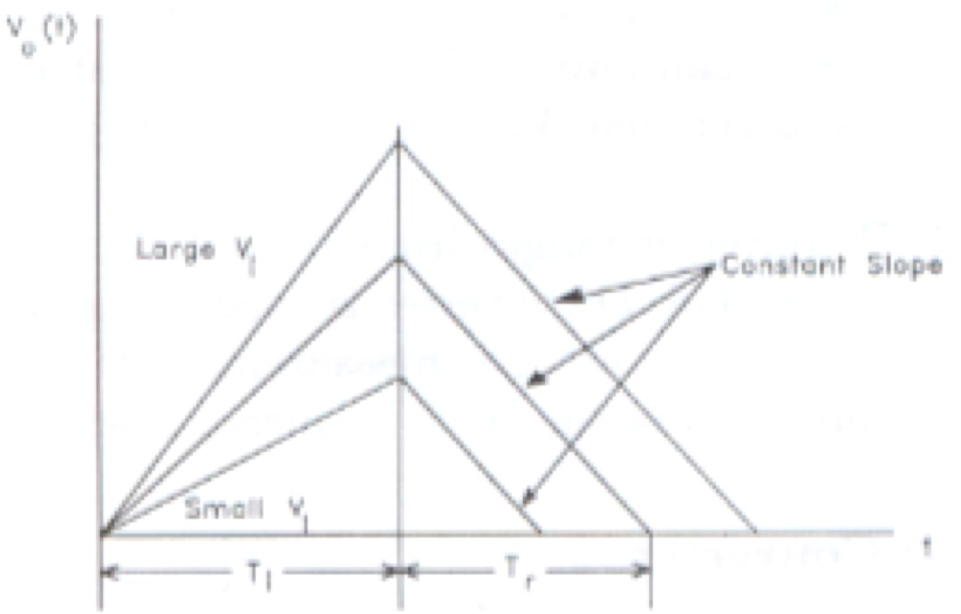
How Does it Work Cont.?
At t < 0, S₁ is set to ground, S₂ is closed, and counter = 0.
At t = 0, a conversion begins and S₂ is open, and S₁ is set so the input to the integrator is V_{in}.
S₁ is held for T_{INT} which is a constant predetermined time interval.
When S₁ is set the counter begins to count clock pulses, the counter resets to zero after T_{INT}
V_{o} of integrator at t = T_{INT} is V_{IN}T_{INT}/RC is linearly proportional to V_{IN}
At t = T_{INT}, S₁ is set so -V_{ref} is the input to the integrator which has the voltage V_{IN}T_{INT}/RC stored in it.
The integrator voltage then drops linearly with a slope of -V_{ref}/RC.
A comparator is used to determine when the output voltage of the integrator crosses zero
When it is zero the digitized output value is the state of the counter.

Slide 55
Dual Slope A/D Converter
PROS
Conversion result is insensitive to errors in the component values.
Fewer adverse affects from “noise”
High Accuracy
CONS
Slow
Accuracy is dependent on the use of precision external components
Cost

Slide 56
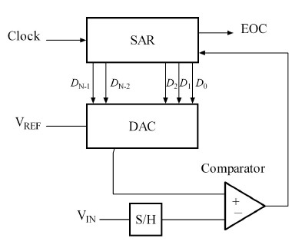
Successive Approximation ADC Circuit
Uses a N-bit DAC to compare DAC and original analog results.
Uses Successive Approximation Register (SAR) supplies an approximate digital code to DAC of V_{IN}.
Comparison changes digital output to bring it closer to the input value.
Uses Closed-Loop Feedback Conversion

Slide 57
Successive Approximation
Advantages
Disadvantages
Capable of high speed and reliable
Medium accuracy compared to other ADC types
Good trade-off between speed and cost
Capable of outputting the binary number in serial (one bit at a time) format.
Higher resolution successive approximation ADC’s will be slower
Large are due to capacitors

Slide 58
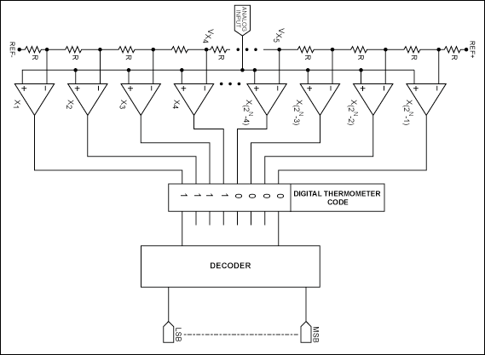
Flash A/D Converter
Fundamental Components (For N bit Flash A/D)
  2^{N-1} Comparators
  2^{N} Resistors
  Control Logic

Slide 59
How does it work?
Uses the 2^{N} resistors to form a ladder voltage divider, which divides the reference voltage into 2^{N} equal intervals.
Uses the 2^{N}-1 comparators to determine in which of these 2^{N} voltage intervals the input voltage V_{in} lies.
The Combinational logic then translates the information provided by the output of the comparators
This ADC does not require a clock, so the conversion time is essentially set by the settling time of the comparators and the propagation time of the combinational logic.

Slide 60
Flash A/D Converter
PROS
Very Fast (Fastest)
Very simple operational theory
Speed is only limited by gate and comparator propagation delay
CONS
Expensive
Prone to produce glitches in the output
Each additional bit of resolution requires twice the comparators.

Slide 61
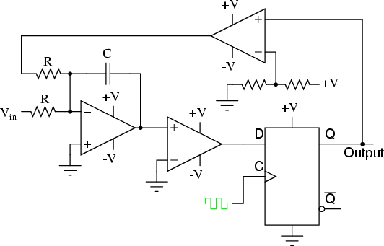
SIGMA-DELTA A/D Converter
Main Components
  Resistors
  Capacitor
  Comparators
  Control Logic
  DAC

Slide 62
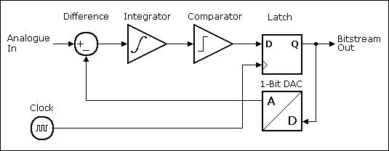
How does it work?
Input is over sampled and goes to integrator.
The integration is then compared to ground.
Iterates and produces a serial bit stream
Output is a serial bit stream with # of 1’s proportional to Vin
With this arrangement the sigma-delta modulator automatically adjusts its output to ensure that the average error at the quantizer output is zero.
The integrator value is the sum of all past values of the error, so whenever there is a non-zero error value the integrator value just keeps building until the error is once again forced to zero.

Slide 63
Sigma-Delta A/D Converter
PROS
High Resolution
No need for precision components
CONS
Slow due to over sampling
Only good for low bandwidth

Slide 64
ADC Types Comparison
ADC Resolution Comparison
Dual Slope
Flash Successive Approx
Sigma-Delta
0
5
10 15
Resolution (Bits)
20
25
Type | Speed (relative) | Cost (relative)
Dual Slope | Slow | Med
Flash | Very Fast | High
Successive Appox | Medium – Fast | Low
Sigma-Delta | Slow | Low

Slide 65
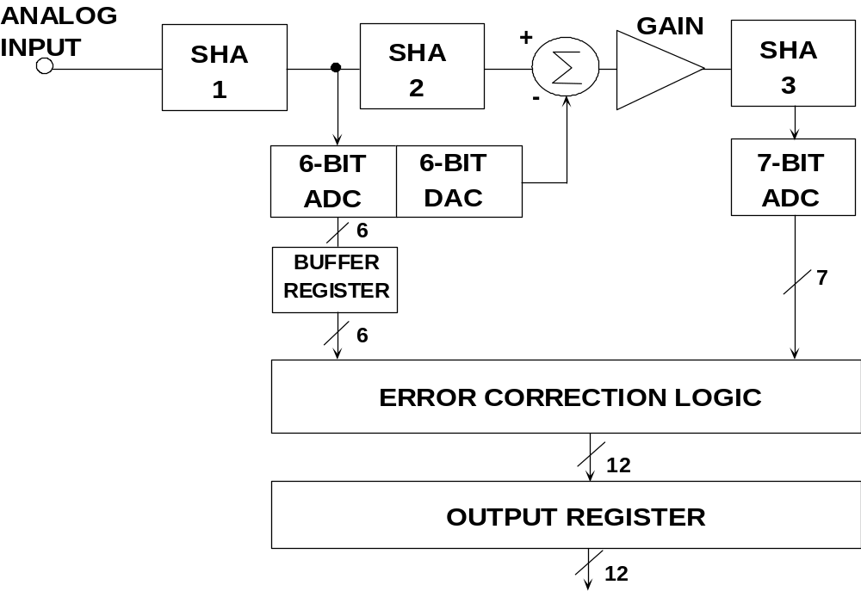
Pipelined Sub-ranging ADC
Conversion divided into discrete stages thus causing pipeline delay
  1st Stage ADC is 6-bit FLASH
  2nd Stage ADC is 7-bit Flash
  Total resolution is 12 bits (one bit used for error correction)
Notes:
The subranging architecture is a great way to achieve higher resolutions. For example a 12-bit flash ADC would need (2¹²-1 = 4095) comparators, but a sub-ranging ADC only needs (2⁶-1 + 2⁷-1 = 190) comparators. The additional circuitry needed is much less than the fewer comparators needed. The reduction in circuitry is what provides the lower power and die size.
The operation of a sub-ranging ADC is much like the successive approximation ADC except it resolves more than one bit at a time. For this example, the ADC does a rough 6-bit conversion, (result is code X). The result of this conversion is passed to a DAC which outputs a “perfect” analog reference for code X. The difference between the actual analog input and the “perfect” output of the DAC is passed to second ADC which makes fine conversion.
The output of the two conversions is combined using logic into one 12-bit word. Note, an extra bit of resolution is needed in the second ADC in order to perform error correction. Error correction is needed because of offsets between the two stages.

Slide 66
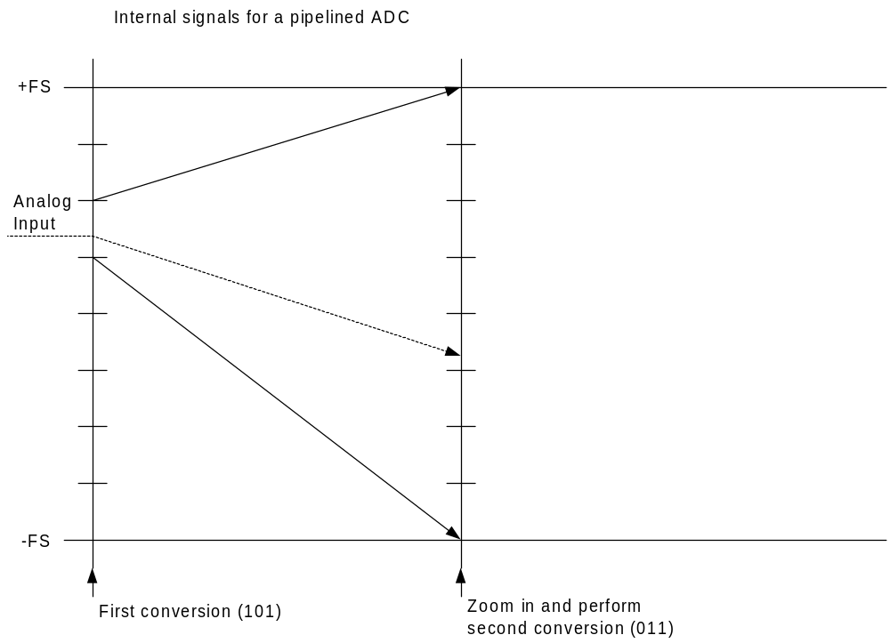
Pipelined Sub-ranging ADC
Notes:
This slide shows an example of how a sub-ranging ADC works. First, the rough ADC does a conversion. The DAC creates a reference voltage which is compared to the original analog signal. The resulting residue signal is then gained up and passed to a second “fine” ADC. The entire range of the second converter should equate to one “step” of the first ADC. After the second ADC is finished the complete word is put together. For this example, the output would be 101001. Note: no error correction is show in this example.

Slide 67
Pipelined Sub-ranging ADC
Advantages to Pipelined Sub-ranging A/D converters
  Higher resolutions at high-speeds
  Digitize wideband inputs
Tradeoffs to pipelined sub-ranging A/D converters
  Higher power dissipation
  Larger die size
Typical Applications
  Communications
  Medical imaging
  Radar
Notes:
This slide shows an example of how a sub-ranging ADC works. First, the rough ADC does a conversion. The DAC creates a reference voltage which is compared to the original analog signal. The resulting residue signal is then gained up and passed to a second “fine” ADC. The entire range of the second converter should equate to one “step” of the first ADC. After the second ADC is finished the complete word is put together. For this example, the output would be 101001. Note: no error correction is show in this example.

Slide 68

Analog Input Signal Definitions
Notes:
There are various different types of analog inputs and this slide explains the differences between them.
The first diagram shows a Unipolar, Single Ended analog input signal. The analog input is applied to the VIN pin of the ADC, has an amplitude of the Full scale input voltage (FS) and spans from 0V to +FS.
The second diagram shows a Unipolar, Fully Differential analog input signal. In this case, the ADC has a positive and a negative analog input, VIN+ and VIN-. These inputs are driven by two equal signals which span from 0 V to +FS, that are 180° out of phase.
The third diagram shows a Bipolar, Single Ended analog input signal. The analog input is applied to the VIN pin of the ADC, has an amplitude of ±FS/2 and is centered on ground.
The fourth diagram shows a Bipolar, Fully Differential analog input signal. In this case, the ADC has a positive and a negative analog input, VIN+ and VIN-. These inputs are driven by two equal signals of amplitude ±FS/2, that are 180° out of phase. The two inputs are centered on ground.
The fifth diagram shows a Pseudo Differential analog input signal. In this case, the ADC has a positive and a negative analog input, VIN+ and VIN-. The positive input is driven by a signal of amplitude FS, and the negative input is driven by a small DC voltage to provide an offset from ground or a ‘pseudo ground’ for the VIN+ signal.

Slide 69
Unipolar and Bipolar Converter Codes
FS - 1LSB
FS - 1LSB
FS - 1LSB
0
0
0
ALL
ALL
"1"s
"1"s
1 AND ALL "0"S
-FS
-(FS - 1LSB)
UNIPOLAR
OFFSET BINARY
2’s COMPLEMENT
Notes:
This slide shows the ideal transfer function of three A/D converters with different digital code representations of an analog input signal. The unipolar transfer function (left-most plot) represents an A/D converter which handles an analog input range from 0 to +FS (Full Scale). The digital output code goes from all 0’s for an analog input voltage of 0V to all 1’s for an analog input voltage of FS–1 LSB. This code format is oftentimes called straight (or natural) binary. The number of discrete values along the way depends on the resolution of the converter.
The middle plot shows the transfer function for an A/D converter which handles a bipolar input range from –FS to +FS. In this case, the digital code is called offset binary where a digital output code of all 0’s represents –FS, a code of 1 and all 0’s (I.e. MSB is 1 and all other bits are 0) represents an analog input of 0V and a code of all 1’s represents an anlog input of FS-1LSB.
Finally, the 3rd plot represents an A/D converter which handles the same analog input voltage range as that just described but represents the digital output via 2’s complement coding. This coding is the same as that just outlined for the offset binary case but has the MSB of the digital word inverted. In effect, this MSB acts like a sign bit which is one for negative signals.

Slide 70
Offset And Gain for Unipolar Ranges
ACTUAL
ACTUAL
GAIN
ERROR
IDEAL
IDEAL
ZERO ERROR
OFFSET
WITH GAIN ERROR:
NO GAIN ERROR:
OFFSET ERROR = 0
ZERO ERROR = OFFSET ERROR
0
0
Notes:
Up to now, the transfer functions shown have been for ideal A/D converters. However, this is not the case in the real world and there are error sources in the A/D converter which will result in a non-ideal transfer function. Let’s look first at two sources of linear error, offset and gain.
First, we will look at the effects of these errors on the transfer function of a unipolar A/D converter. The effect of the offset error is to shift the entire transfer function either up or down (the example shown is for moving the transfer function up, representing a positive offset error). The offset error shifts every code of the A/D converter by an equal amount. Therefore, if the A/D converter has an offset of +2LSB, each digital output code will be shifted by +2LSB from its ideal representation.
The effect of gain error is shown in the right-hand plot. The transfer function shown assumes no offset error. The gain error has the effect of changing the slope of the transfer function. From an absolute value perspective, the gain error shifts each digital output code by a different amount. However, the effect is linear with each output being changed by an equal percentage of its correct value.

Slide 71
Offset And Gain for Bipolar Ranges
ACTUAL
ACTUAL
IDEAL
IDEAL
0
0
ZERO ERROR
ZERO ERROR
OFFSET
NO GAIN ERROR:
WITH GAIN ERROR:
ERROR
ZERO ERROR = OFFSET ERROR
OFFSET ERROR = 0
ZERO ERROR RESULTS
FROM GAIN ERROR
Notes:
This shows the effects of offset and gain errors on A/D converters with bipolar transfer functions. Of note here is the distinction between offset error and zero error. In this case, the true offset error is seen at negative full scale. However, for many bipolar A/D converters, the user is interested in the deviation from ideal at 0V analog input (zero error). With no gain error, the offset error and zero error are the same. However, when gain error effect is shown (as in the right-hand plot), there is a zero error in the A/D transfer function whereas there is no offset error.

Slide 72

DC Specifications (DNL)
Differential Non-Linearity (DNL) is the deviation of an actual code width from the ideal 1 LSB code width
Results in narrow or wider code widths than ideal and can result in missing codes
Results in additive noise/spurs beyond the effects of quantization
Notes:
The ideal width for each code is 1LSB but in practice each code width is different from its neighbours. A DNL error is defined as the difference between the ideal 1 LSB step and the actual (real) step as one moves along the transfer function (DNL = actual - ideal). Thus, in the plot shown above, we are measuring the actual width of each code. For example a code with a width of 1.5 lsb would have a DNL of 1.5 - 1.0 = 0.5 lsb. A missing code would have a width of zero and would have a DNL of 0 - 1.0 = -1.0 lsb. DNL can never be less than -1.0, but has no upper limit.
The effect of DNL error is to add “noise/spurs” to an ideal transfer function. This reduces the accuracy of the conversion beyond the limitations of quantization.

Slide 73

Missing Codes
Many A/D converter data sheets specify “no missing codes” as this specification can be critical in some applications, such as in servo systems.

Slide 74

DC Specifications (INL)
Integral Non-Linearity (INL) is the deviation of an actual code transition point from its ideal position on a straight line drawn between the end points of the transfer function.
INL is calculated after offset and gain errors are removed
Results in additive harmonics and spurs
Notes:
INL error is not a measure of code width. It is a measure of the error in a code’s transition point. Ideally, the transition points should occur at exactly the 1/8th, 1/4th, etc voltages. Errors in the converter cause the actual code transitions to deviate from ideal. INL is usually measured with respect to code centres and is the worst deviation of any code centre from an ideal straight line drawn between the endpoints of the transfer function. This ideal straight line is calculated after both offset and gain errors are removed. Thus, in the plot shown above, we are measuring the deviation of its actual transition point from its ‘ideal’ transistion point after gain and offset are removed.
Just like DNL, INL results in a reduction in accuracy of the converter. However, unlike DNL, INL errors can result in added harmonic components. (This will be demonstrated on the next slide.)

Slide 75
Nyquist Bandwidth & Aliasing
2 signals that are mixed together produce sum and difference frequency components
Nyquist theory stipulates that the signal frequency, F_{SIGNAL} must be < to ½ F_{SAMPLING} to prevent a condition known as “aliasing”, in which the difference component appears within the signal bandwidth of interest
Notes:
Read Through Bullets

Slide 76
The Nyquist Bandwidth & Aliasing
f_{signal}
f_{sampling} - f_{signal}
f_{sampling}
f_{sampling} + f_{signal}
signal
passband
1 MHz
3 MHz
4 MHz
5 MHz
The signal frequency is < 1/2 the sampling frequency and so the sum and difference components fall outside (beyond) the signal passband
Notes:
The Signal Frequency Is < 1/2 the Sampling Frequency and so the Sum and Difference Components Fall Outside (Beyond) the Signal Passband

Slide 77
The Nyquist Bandwidth & Aliasing
f_{sampling}- f_{signal}
f_{sampling} + f_{signal}
f_{signal}
f_{sampling}
“Alias”
0.5 MHz
1 MHz
1.5 MHz
2.5 MHz
The signal frequency is > 1/2 (approx 2/3) the sampling frequency. An “alias” or false image is thus created that falls within the passband of interest.
Notes:
The Signal Frequency Is > 1/2 (approx 2/3) the Sampling Frequency. An “Alias” or False Image is Thus Created that Falls Within the Passband of Interest. There are specific applications where the input signal is bandlimited whereby the A/D converter can actually resolve input frequencies which are beyond the Nyquist frequency. These applications are known as undersampling applications.

Slide 78

Aliasing in time domain

Slide 79


SINAD, ENOB and SNR
SINAD (Signal-to-Noise-and-Distortion Ratio)
  The ratio of the rms signal amplitude to the mean value of the root-sum-squares (RSS) of all other spectral components, including harmonics, but excluding dc
ENOB (Effective Number of Bits)
SNR (Signal-to-Noise Ratio, or Signal-to-Noise Ratio Without Harmonics)
  The ratio of the rms signal amplitude to the mean value of the root-sum-squares (RSS) of all other spectral components, excluding the first five harmonics and dc
Notes:
One of the basic ADC figures of merit is its ability to convert the signal of interest and keep it separate from other noise elements within the signal chain. It’s best defined as the ratio of the rms signal amplitude to the mean value of the root sum squares of all the spectral components. SINAD is this ratio that includes all harmonics. SNR is this ratio but it excludes the first 5 harmonics. ENOB or effective number of bits is another figure of merit and can be derived from SINAD.
It is interesting to note that SNR does depend on signal input level. In an ideal converter, the higher the input level, the higher the SNR. Unfortunately, in the real world the ADC has a maximum input level. Take this plus the fact that it is not an ideal converter, there is a slightly different curve. (solid line vs the dotted line)
======================================
Clipping …in the ADC defines the SNRmax (full scale range)
Delta between are based on the errors introduced in the Rx signal chain…. A perfect converter, quant error exists… other errors intro’d into signal chain (and others within the ADC)… increase this delta.

Slide 80

SFDR and THD
SFDR = The difference between the rms power of the fundamental and the largest spurious signal in a given bandwidth
THD = The ratio of the rms sum of the first six harmonics to the amplitude of the fundamental
Notes:
Spurious free dynamic range and total harmonic distortion are easily explained by this picture. SFDR is the distance between the signal of interest and the highest spur, including harmonics. THD is the distance relative to the signal of interest and the rms sum of a defined set of harmonics. SNR is the distance (ratio) from the signal of interest to the noise floor.

Slide 81

ADC Figures of Merit
$$FoM= \frac{Power}{F_{s}∙2^{ENOB}}[J/conv]$$
Sometimes inverse of this metric is used
In typical circuits power ~ speed, FOM captures this tradeoff correctly
How about power vs. ENOB?
  One more bit 2x in power?

